Slide 1
Team 5 Conceptual Design
Dillon Williams
Nidhay Patel
Ryan Reed
Michel Turpeau
Austin Sigg

Slide 2
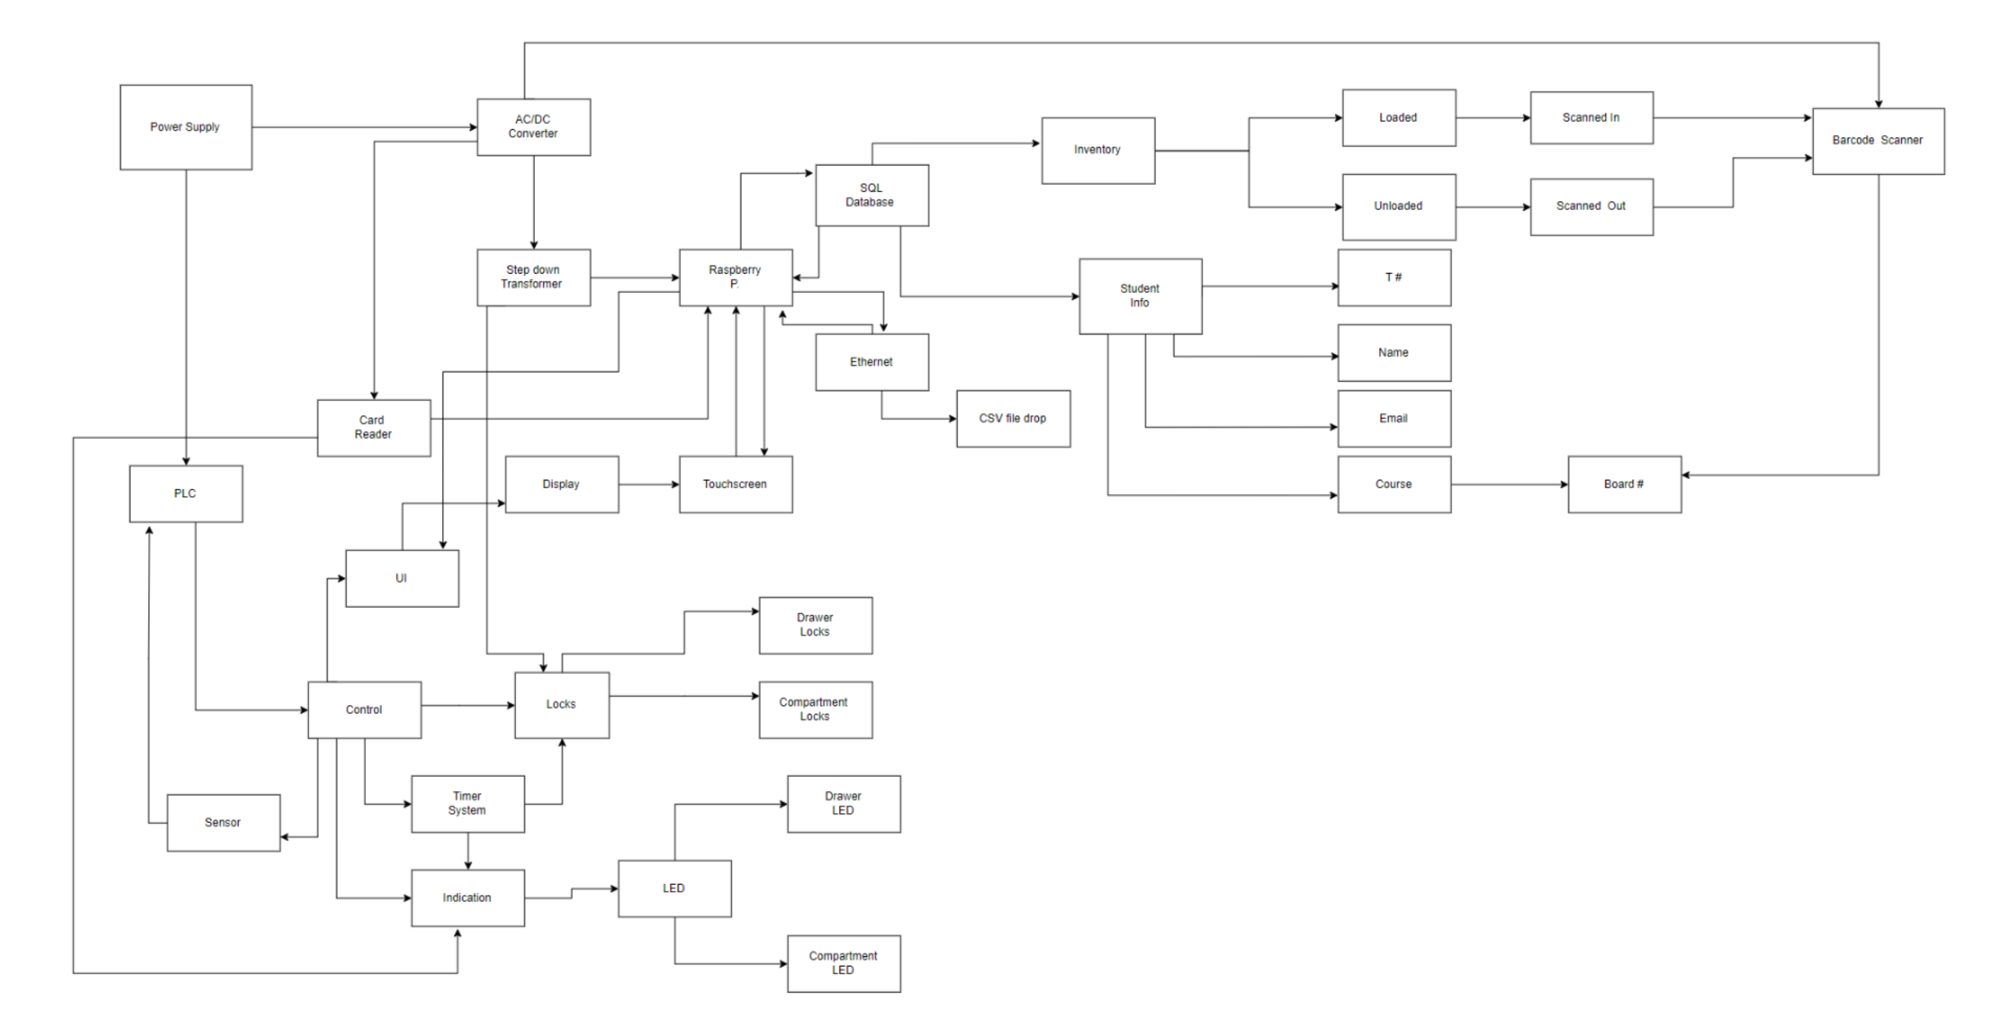

Slide 3
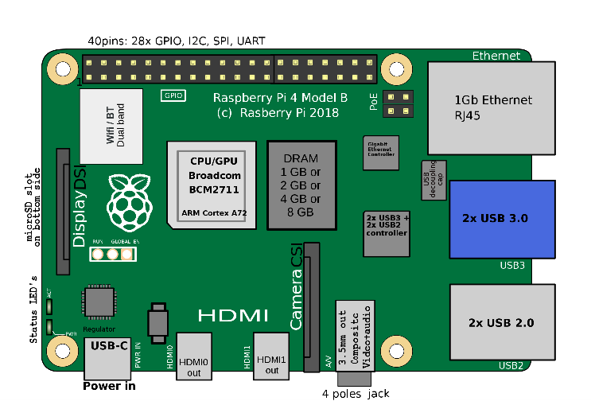
Microcontroller
Raspberry Pi Model 4 B
Card Reader
Input: Signal/Message/Information from Eagle Card
Output: Create Data and signal Microcontroller Unit
UI
Raspberry Pi LCD touchscreen
Input: Information from Student
Output: Raspberry Pi signaling PLC

Slide 4
Pi connections
Raspberry Pi
SQL Database
Touchscreen
Eagle Card Reader
Ethernet

Slide 5
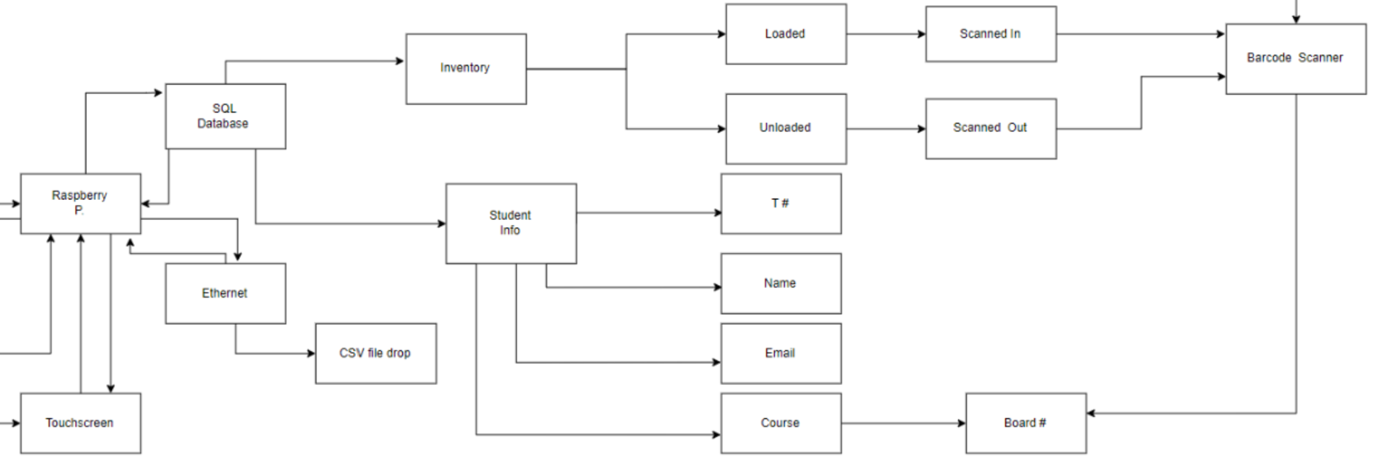
SQL Database
Inventory
Loaded
Unloaded
Student Information
T#
Name
Email
Course & Board#
Ethernet
CSV File

Slide 6
Ryan

Slide 7
Mick

Slide 8
Sigg

